Slide 1
Energy and power Review
Mini tests are this Friday.

Slide 2
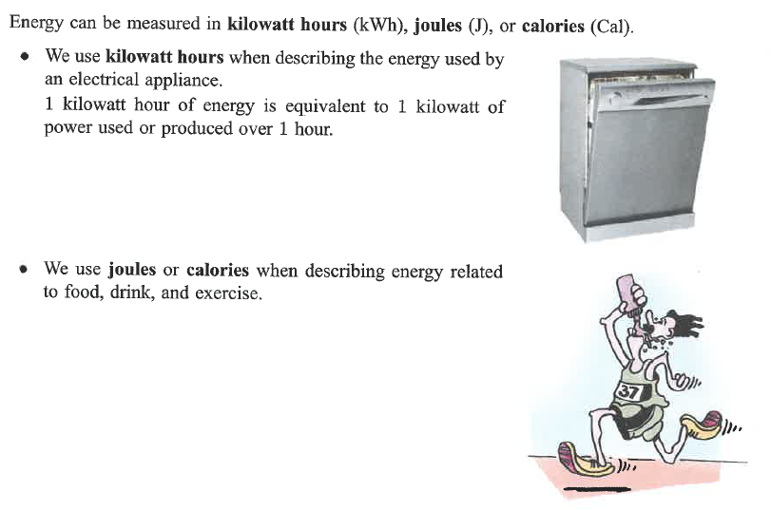
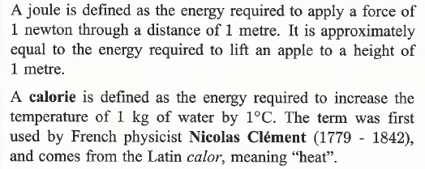

Slide 3
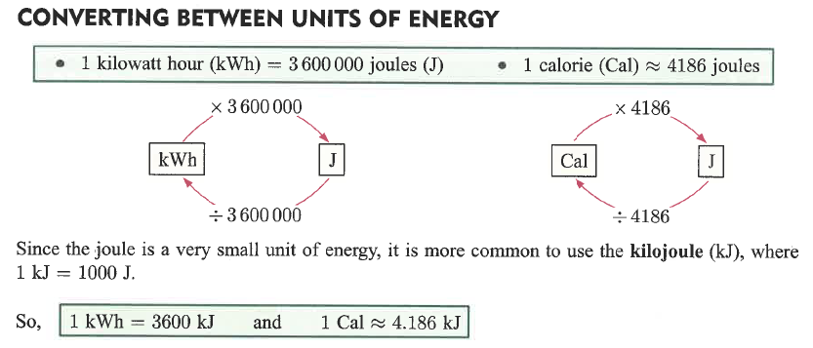
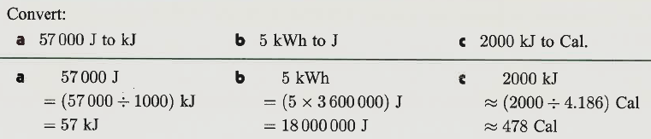
Example

Slide 4
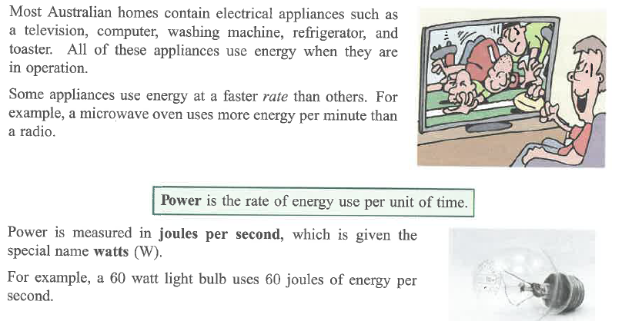

Slide 5
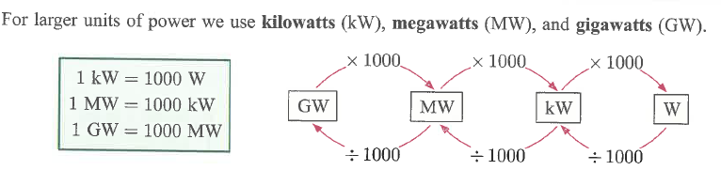
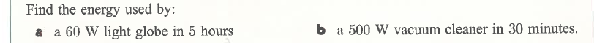
Energy used by an appliance (in kilowatt hours) = Power (in kw) x time (in hours)
E = Power x time (in kWhours)
60w = 0.06kW
E = 0.06 x 5
= 0.3kWh
500w = 0.5kW
E = 0.5 x 0.5
= 0.25kWh

Slide 6
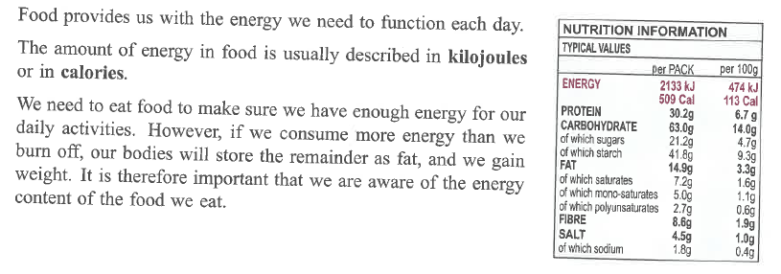

Slide 7
